Slide 1
Python Programming CT108-3-1
BSc.IT First Semester
Techspire College
New Baneshwor, Kathmandu

Slide 2
Course Content Outline and Subtopics
Introduction to programming
Control Structure – Sequential, Selection and Iteration
Data Collection
String Interpolation
Modular Programming
File Handling
Introduction to Problem Solving and Program Design
Program Design Techniques – Pseudocode and Flowchart
Outline the problem solving process
Develop algorithm
Apply problem solving technique using pseudocode and flowchart
Practical Exercise and Lab Assignments

Slide 3
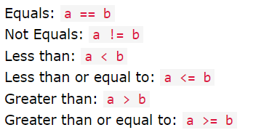
Control Flow
The order in which the program’s code executes
The control flow of a python program is regulated by conditional statements, loops and function calls
Python supports logical conditions from mathematics
These statements are mostly
used by “if statement” and
loops.

Slide 4
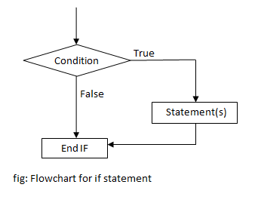
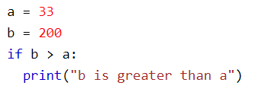
Control Flow
Decision Making Structure
if Statement
An “if statement” is written by if keyword. Example
Python relies on indentation
Indentation define scope in the code

Slide 5
Decision Making Structure The if-statement
Syntax:
if condition:
statements
Attention: Indentation
Python relies on indentation (whitespace at the beginning of a line) to define scope in the code. Other programming languages often use curly-brackets for this purpose.
If statement, without indentation (will raise an error):
a = 33 b = 200 if b > a: print("b is greater than a") # you will get an error
Example:
a = 33 b = 200 if b > a: print("b is greater than a")
In this example we use two variables, a and b, which are used as part of the if statement to test whether b is greater than a. As a is 33, and b is 200, we know that 200 is greater than 33, and so we print to screen that "b is greater than a"

Slide 6
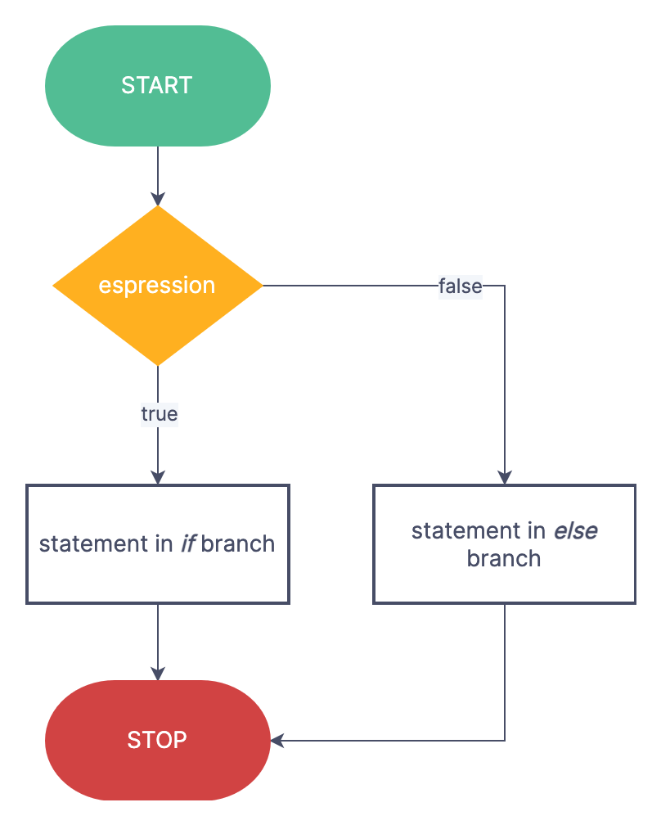
Decision Making Structure The if.. else statement:
Syntax:
if condition:
statements
else:
statements
The else keyword catches anything which isn't caught by the preceding conditions.
Example:
a = 200 b = 33 if b > a: print("b is greater than a")
else:
print(“a is greater than b”)
In this example, as a is 200, and b is 33, we know that 200 is greater than 33, and so we print to screen that “a is greater than b“ which is at else statement

Slide 7

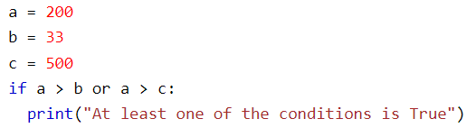
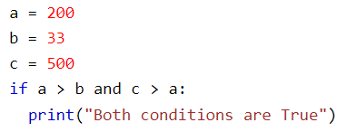
Decision Making Structure The if.. else statement:
One line if else statement with 3 conditions
The or and and keyword is a logical operator used to combine conditional statements

Slide 8
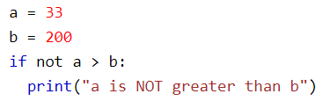
Decision Making Structure The if.. else statement:
The not keyword is a logical operator used to reverse the result of the conditional statements

Slide 9
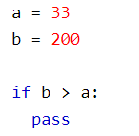
Decision Making Structure The pass statement:
if statements cannot be empty, but if you for some reason have an if statement
with no content, put in the pass statement to avoid getting an error.

Slide 10
Decision Making Structure The elif statement
The elif keyword is pythons way of saying "if the previous conditions were not true, then try this condition".
SYNTAX:
if condition:
statements
elif condition:
statements
Example:
a = 33 b = 33 if b > a: print("b is greater than a") elif a == b: print("a and b are equal")
In this example a is equal to b, so the first condition is not true, but the elif condition is true, so we print to screen that "a and b are equal".

Slide 11
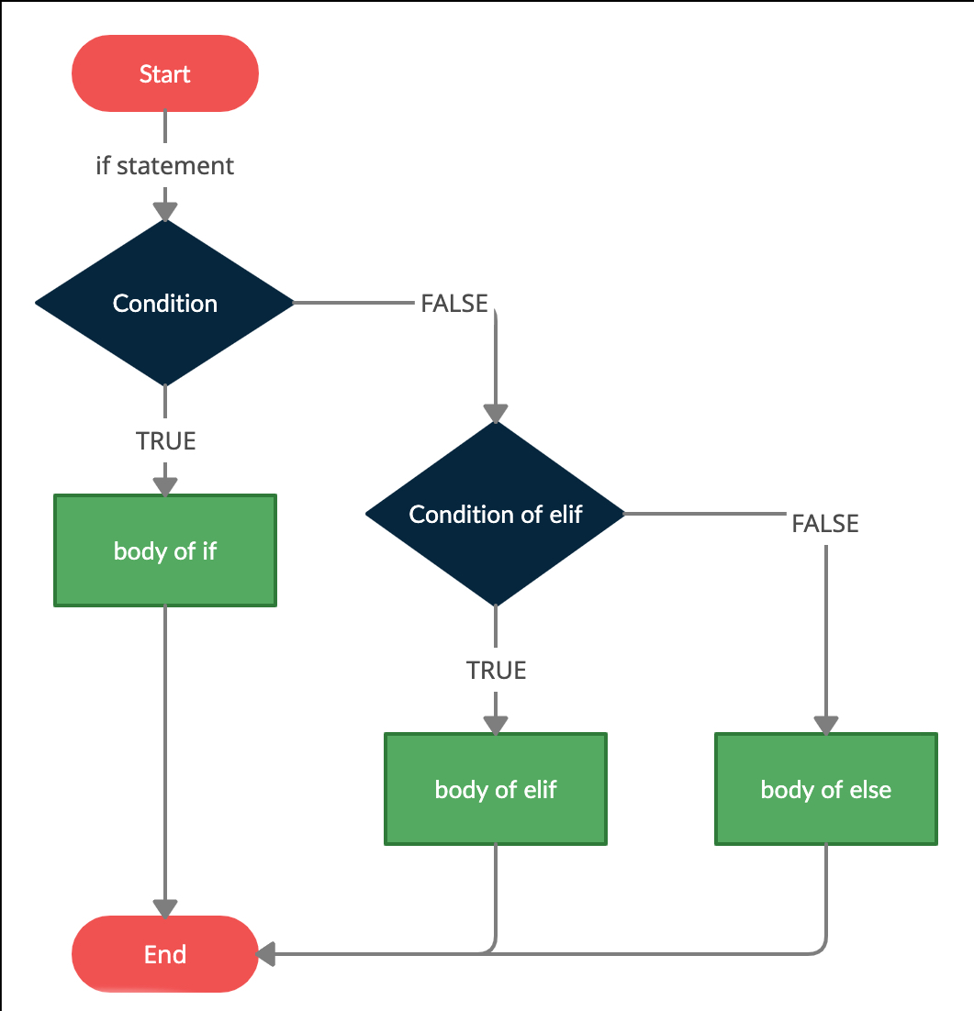
Decision Making Structure The if….elif…else statement
SYNTAX:
if condition:
statements
elif condition:
statements
else:
statements
Example:
a = 200 b = 33 if b > a: print("b is greater than a") elif a == b: print("a and b are equal") else: print("a is greater than b")
In this example a is greater than b, so the first condition is not true, also the elif condition is not true, so we go to the else condition and print to screen that "a is greater than b".

Slide 12
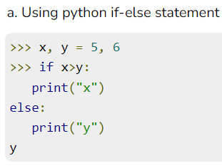
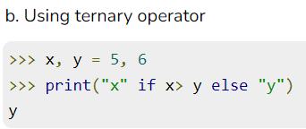
Decision Making Structure Ternary Operator
SYNTAX:
[on_true] if [expression] else [on_false]
used to return a value based on the result of a binary condition

Slide 13
More examples:
Note:
USING f-strings: SYNTAX: f“string_with_variables_in_braces”
Example:
band_name, members = ‘cobweb’, 5
print(f“Hello {band_name}. You have {members} band members.”)
EXAMPLE:
language = 'Java'
if language == 'Python':
print(f"Yes,{language} is a language")
elif language == 'Java':
print(f"Yes,{language} is also a language")
else:
print(f'I don’t think {language} is a language')
Do the above example with user-entered values!!!

Slide 14
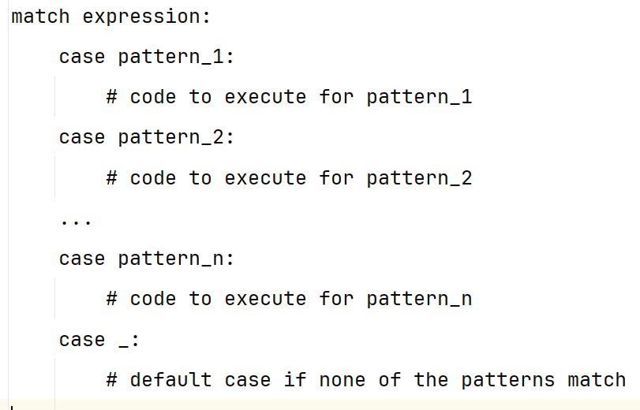
Decision Making Structure Match Statement
Match statement in python was introduced in Python 3.1
It allows us to match a value against patterns and execute corresponding code
Syntax:

Slide 15
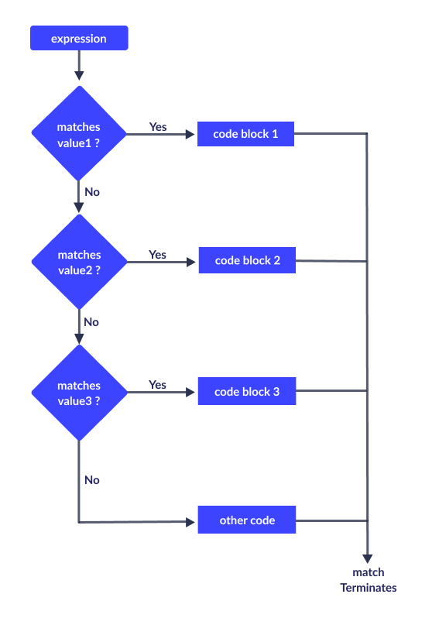
Flowchart of Match Statement

Slide 16
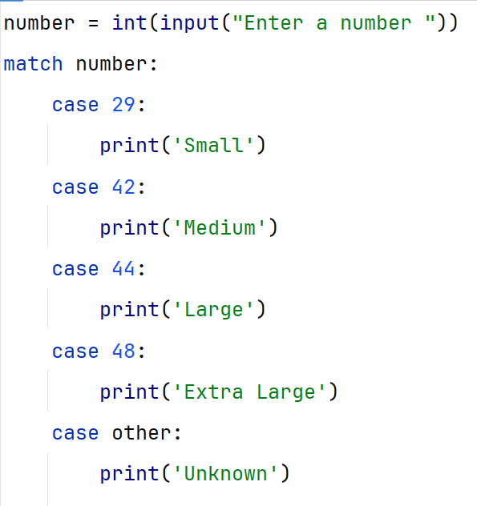
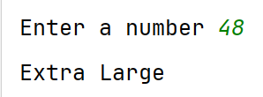

Match Statement Example
Output

Slide 17
Practice Questions with Algorithm and Flowcharts
WAP to take an integer as input and determine whether the number is odd or even.
WAP to read a number and determines whether the number is positive, negative or zero
Using match statement, create a simple calculator that can perform addition, multiplication, subtraction and division
WAP to take a single character as input and determine whether it is vowel and consonant
Develop a program that categorizes a person’s age into “Child”, “Teenager”, ”Adult” and “Senior Citizen”
Write a program that takes three numbers as input and prints the largest among them
Write a program that takes three integer inputs representing the sides of a triangle and outputs whether it's an equilateral, isosceles, or scalene triangle
Create a program that takes the total cost of items purchased and calculates the final cost after applying a discount. The discount percentage should vary based on the total cost:
10% for total cost less than 100
20% for total cost between 100 and 500
30% for total cost greater than 500

